Slide 1


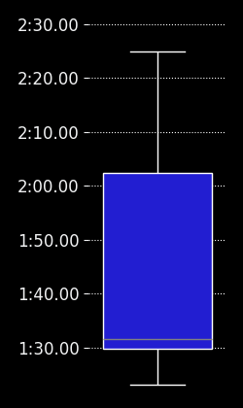
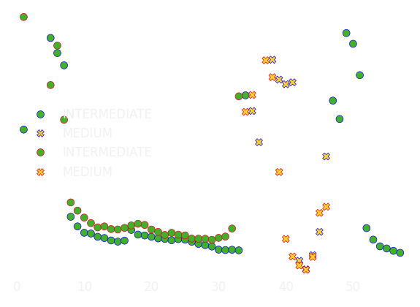
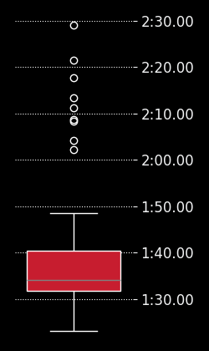
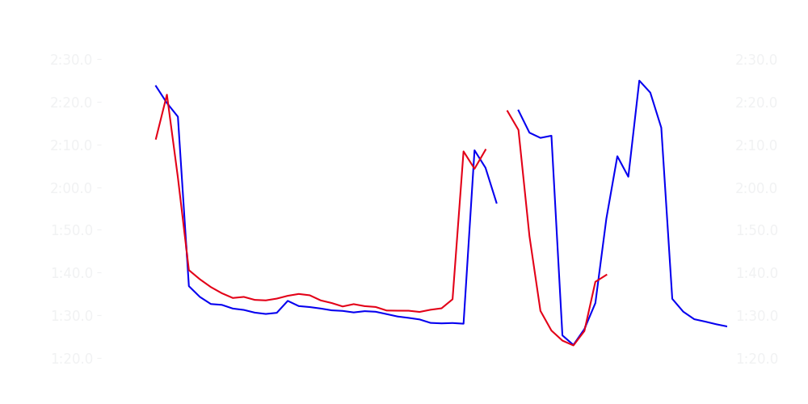
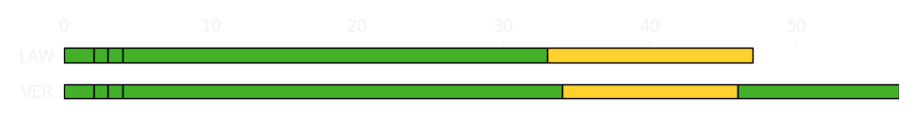
Australian GP Race
Driver
Race Time
Race Time
Driver
Max Verstappen
1:23:23.983
1:03:10.943
Liam Lawson
Avg Lap Time
1:30.686
IQR
Gap
Gap
IQR
Avg Lap Time
3.401 s
-10 laps
+10 laps
3.566 s
1:33.497
Race Comparaison
Race Comparaison
Lap Advantage
33/57
Position
2
Safety Car Lap
20/57
Position
9
Lap Advantage
4/57
Lap Time Per Lap
Lap Time Per Lap
Tyre Strategy
Total Pit Stop Time
01:17.515 s
Pit Stops
5
Pit Stops
4
Total Pit Stop Time
01:10.046 s
Tyre Strategy

Slide 2

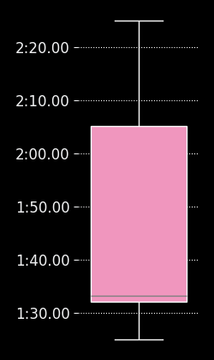
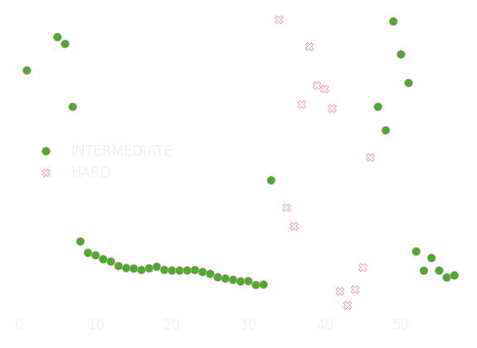

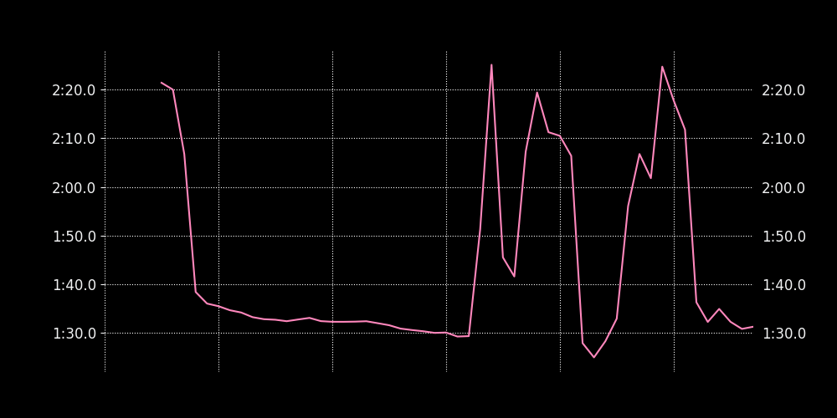
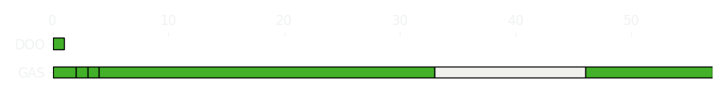
Australian GP Race
Driver
Race Time
Race Time
Driver
Pierre Gasly
1:23:43.397
0
Jack Doohan
Avg Lap Time
1:32.438
IQR
Gap
Gap
IQR
Avg Lap Time
3.568 s
-56 laps
+56 laps
0
0
Race Comparaison
Race Comparaison
Lap Advantage
36/57
Position
11
Safety Car Lap
21/57
Position
DNF
Lap Advantage
0/57
Lap Time Per Lap
Lap Time Per Lap
Tyre Strategy
Total Pit Stop Time
01:24.629 s
Pit Stops
5
Pit Stops
0
Total Pit Stop Time
0:00:00
Tyre Strategy

Slide 3

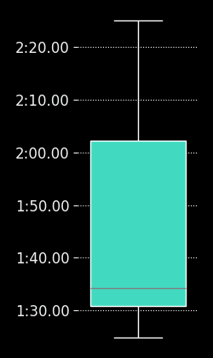
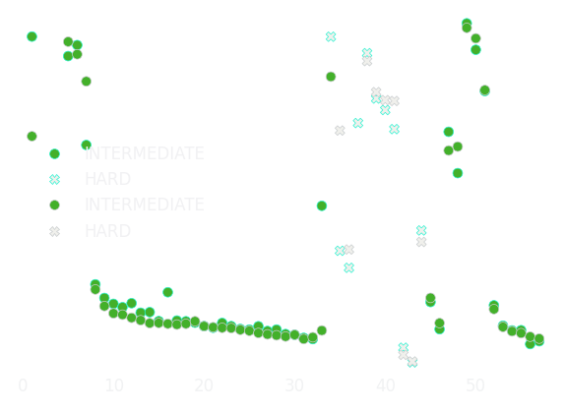
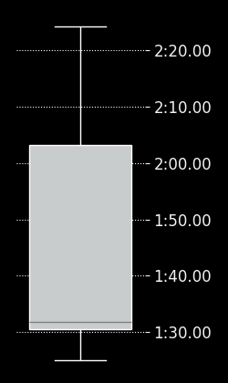
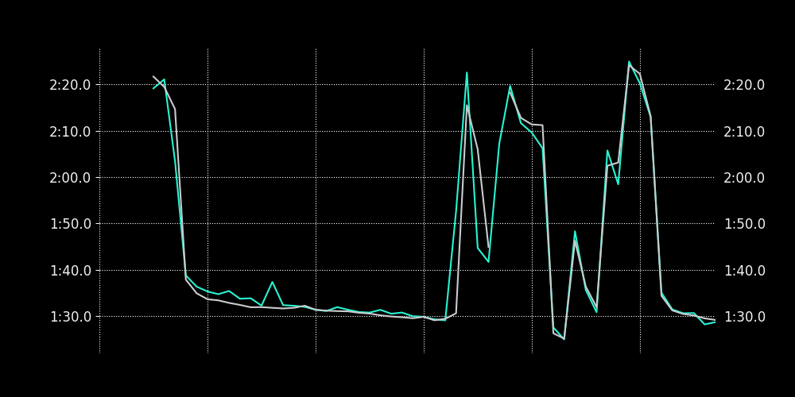
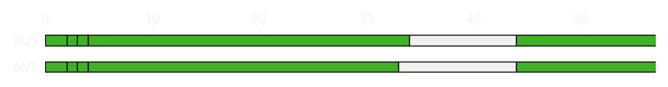
Australian GP Race
Driver
Race Time
Race Time
Driver
Kimi Antonelli
1:23:22.519
1:23:29.333
George Russell
Avg Lap Time
1:31.642
IQR
Gap
Gap
IQR
Avg Lap Time
4.707 s
+01.687 s
-01.687 s
2.404 s
1:31.152
Race Comparaison
Race Comparaison
Lap Advantage
8/57
Position
4
Safety Car Lap
21/57
Position
3
Lap Advantage
28/57
Lap Time Per Lap
Lap Time Per Lap
Tyre Strategy
Total Pit Stop Time
0:00:00
Pit Stops
0
Pit Stops
5
Total Pit Stop Time
01:19.975 s
Tyre Strategy

Slide 4


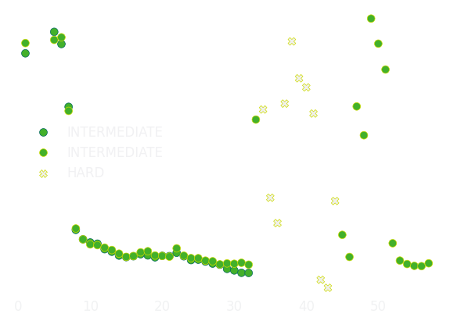
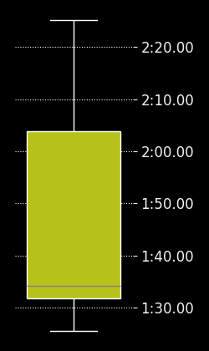
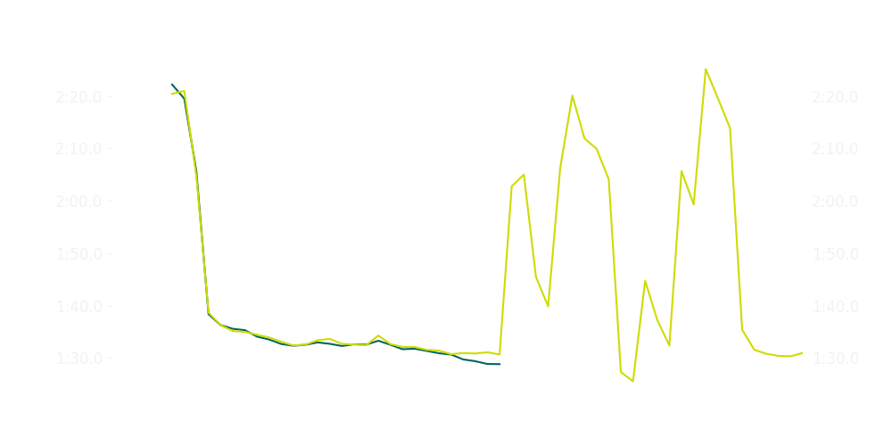
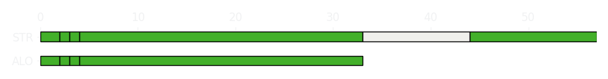
Australian GP Race
Driver
Race Time
Race Time
Driver
Fernando Alonso
0:36:54.204
1:23:31.209
Lance Stroll
Avg Lap Time
1:32.521
IQR
Gap
Gap
IQR
Avg Lap Time
1.939 s
+24 laps
-24 laps
3.682 s
1:32.554
Race Comparaison
Race Comparaison
Lap Advantage
20/56
Position
10
Safety Car Lap
20/56
Position
6
Lap Advantage
16/56
Lap Time Per Lap
Lap Time Per Lap
Tyre Strategy
Total Pit Stop Time
00:46.810 s
Pit Stops
3
Pit Stops
5
Total Pit Stop Time
01:23.673 s
Tyre Strategy

Slide 5

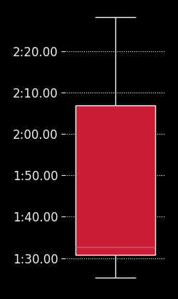
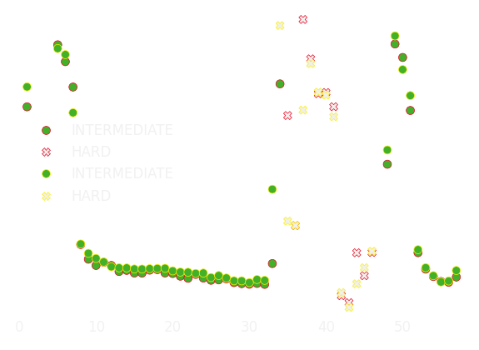
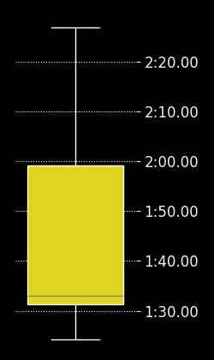
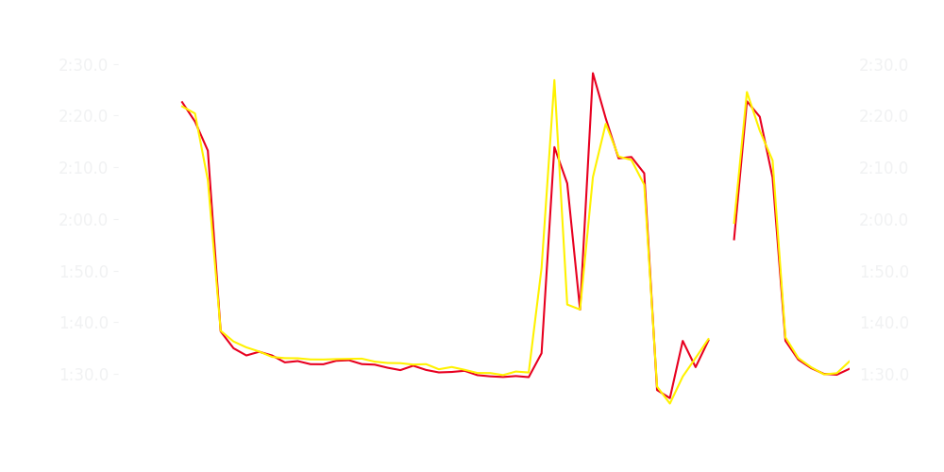
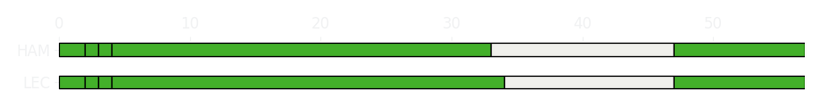
Australian GP Race
Driver
Race Time
Race Time
Driver
Charles Leclerc
1:23:39.633
1:23:40.072
Lewis Hamilton
Avg Lap Time
1:31.756
IQR
Gap
Gap
IQR
Avg Lap Time
3.242 s
-2.62 s
+2.62 s
2.562 s
1:32.418
Race Comparaison
Race Comparaison
Lap Advantage
32/57
Position
8
Safety Car Lap
21/57
Position
10
Lap Advantage
4/57
Lap Time Per Lap
Lap Time Per Lap
Tyre Strategy
Total Pit Stop Time
01:25.614 s
Pit Stops
5
Pit Stops
5
Total Pit Stop Time
01:25.310 s
Tyre Strategy

Slide 6

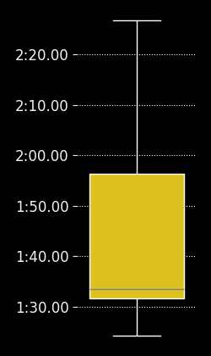
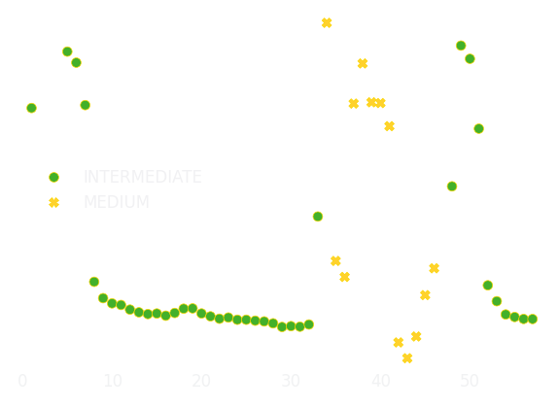

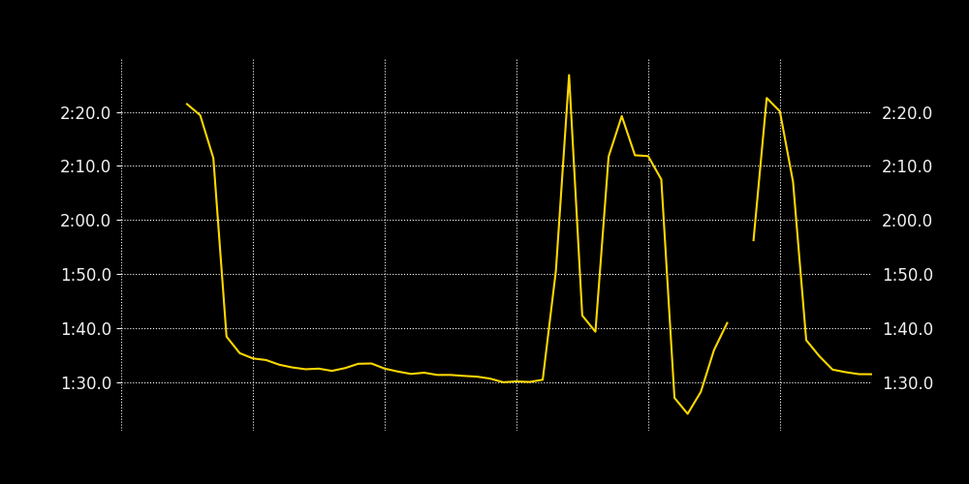
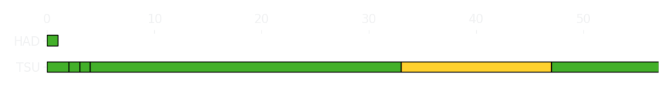
Australian GP Race
Driver
Race Time
Race Time
Driver
Yuki Tsunoda
1:23:48.498
0
Isack Hadjar
Avg Lap Time
1:32.398
IQR
Gap
Gap
IQR
Avg Lap Time
3.198 s
-56 laps
+56 laps
0
0
Race Comparaison
Race Comparaison
Lap Advantage
36/57
Position
12
Safety Car Lap
21/57
Position
DNF
Lap Advantage
0/57
Lap Time Per Lap
Lap Time Per Lap
Tyre Strategy
Total Pit Stop Time
01:22.094 s
Pit Stops
5
Pit Stops
0
Total Pit Stop Time
0:00:00
Tyre Strategy

Slide 7

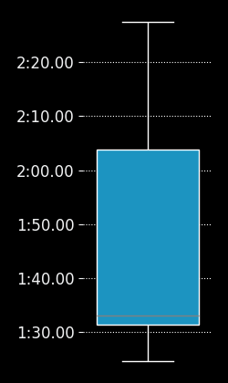
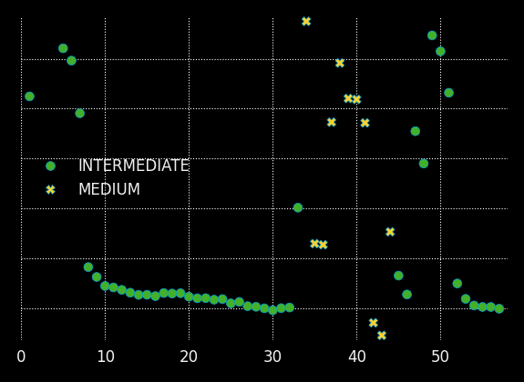

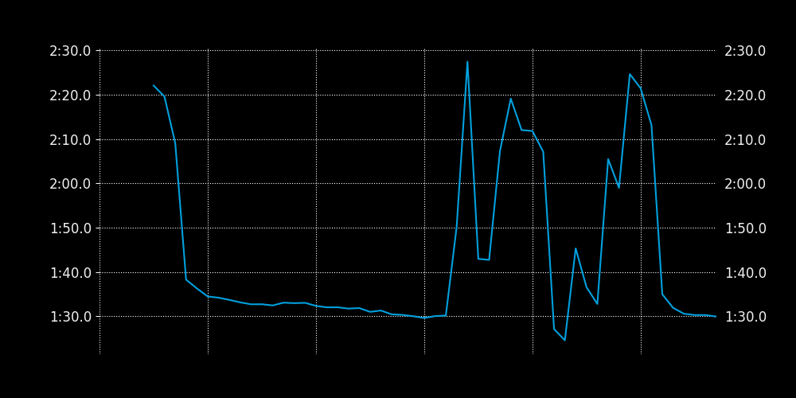
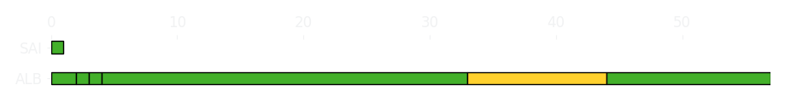
Australian GP Race
Driver
Race Time
Race Time
Driver
Alexander Albon
1:23:31.072
0
Carlos Sainz
Avg Lap Time
1:32.356
IQR
Gap
Gap
IQR
Avg Lap Time
3.567 s
-56 laps
+56 laps
0
0
Race Comparaison
Race Comparaison
Lap Advantage
36/57
Position
5
Safety Car Lap
21/57
Position
DNF
Lap Advantage
0/57
Lap Time Per Lap
Lap Time Per Lap
Tyre Strategy
Total Pit Stop Time
01:23.823 s
Pit Stops
5
Pit Stops
0
Total Pit Stop Time
0:00:00
Tyre Strategy

Slide 8

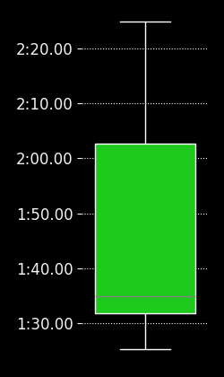
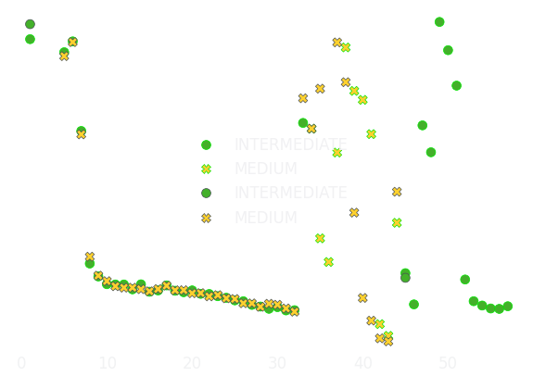
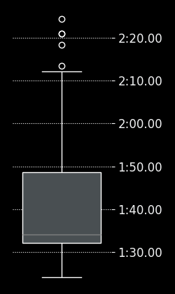
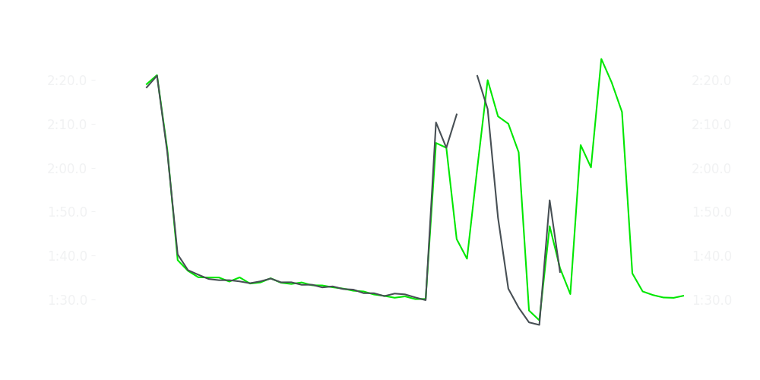
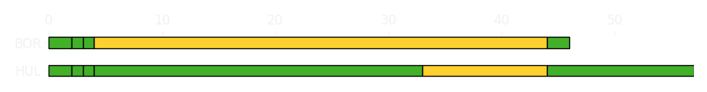
Australian GP Race
Driver
Race Time
Race Time
Driver
Nico Hulkenberg
1:23:31.504
1:01:58.959
Gabriel Bortoleto
Avg Lap Time
1:33.202
IQR
Gap
Gap
IQR
Avg Lap Time
4.096 s
-11 laps
+11 laps
3.064 s
1:33.339
Race Comparaison
Race Comparaison
Lap Advantage
22/56
Position
7
Safety Car Lap
21/56
Position
13
Lap Advantage
13/56
Lap Time Per Lap
Lap Time Per Lap
Tyre Strategy
Total Pit Stop Time
01:26.631 s
Pit Stops
5
Pit Stops
5
Total Pit Stop Time
01:35.288 s
Tyre Strategy

Slide 9


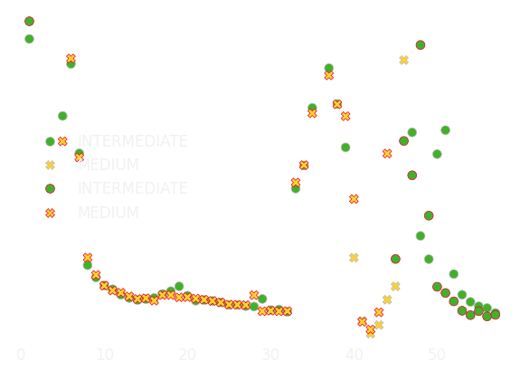
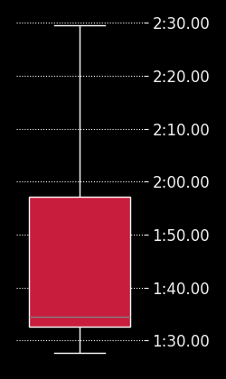
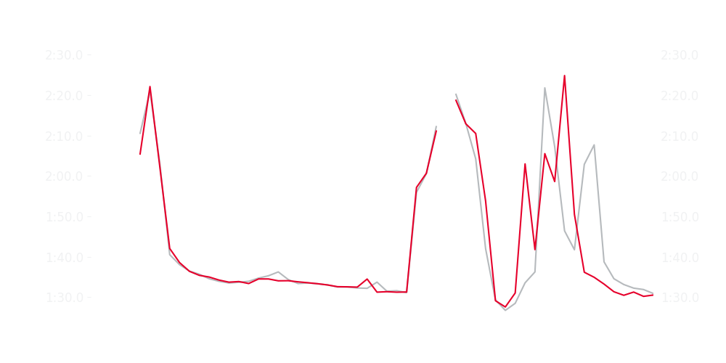
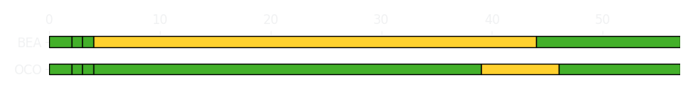
Australian GP Race
Driver
Race Time
Race Time
Driver
Esteban Ocon
1:23:41.462
1:25:26.645
Ollie Bearman
Avg Lap Time
1:33.703
IQR
Gap
Gap
IQR
Avg Lap Time
3.957 s
-7.191 s
+7.191 s
4.43 s
1:33.818
Race Comparaison
Race Comparaison
Lap Advantage
18/57
Position
13
Safety Car Lap
22/57
Position
14
Lap Advantage
17/57
Lap Time Per Lap
Lap Time Per Lap
Tyre Strategy
Total Pit Stop Time
01:29.157 s
Pit Stops
5
Pit Stops
5
Total Pit Stop Time
01:35.257 s
Tyre Strategy

Slide 10

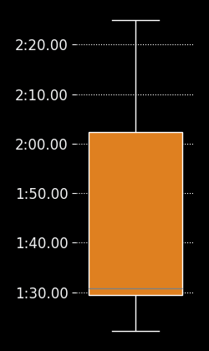
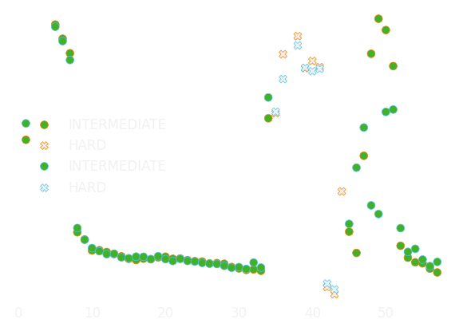
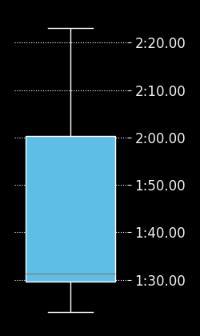
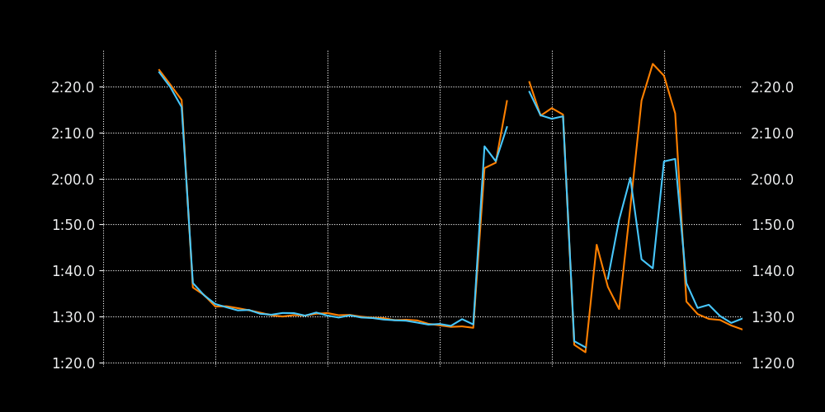
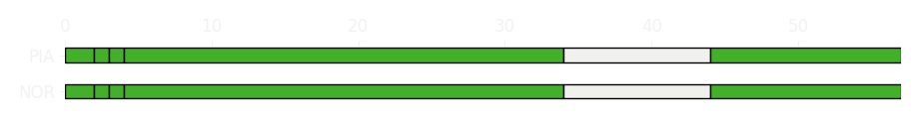
Australian GP Race
Driver
Race Time
Race Time
Driver
Lando Norris
1:23:24.035
1:23:42.496
Oscar Piastri
Avg Lap Time
1:30.186
IQR
Gap
Gap
IQR
Avg Lap Time
2.392 s
-20.471 s
+20.471 s
2.748 s
1:30.186
Race Comparaison
Race Comparaison
Lap Advantage
21/56
Position
1
Safety Car Lap
20/56
Position
9
Lap Advantage
15/56
Lap Time Per Lap
Lap Time Per Lap
Tyre Strategy
Total Pit Stop Time
01:15.550 s
Pit Stops
5
Pit Stops
5
Total Pit Stop Time
01:19.301 s
Tyre Strategy

